Slide 1


MUSIC PLAYER WEBSITE
Presented By
Arya A : 4DM21CS011
Isha I V : 4DM21CS020
Jasnitha Joy : 4DM21CS021
Minal Fathima P : 4DM21CS026
Under the Guidance of:
Mr. Guruprasad G
Asst. Prof. Dept Of CSE

Slide 2
ABSTRACT
This internship opportunity focuses on Full stack web development. Full stack web development is a multifaceted approach to creating interactive and dynamic websites or web applications. This comprehensive skill set covers both the front-end and back-end aspects of development.
On the front-end, a full stack developer must master HTML for structuring content, CSS for styling, and JavaScript for creating interactive user interfaces. Conversely, the back-end involves server-side programming, database management, and server configuration.

Slide 3
INTRODUCTION
Inventeron Technologies, spearheaded by CEO Muhammed Misbah, is a tech powerhouse in Bangalore, redefining industry landscapes.
Inventeron stands as a beacon of innovation. Their commitment extends to nurturing tech talent through hands-on internships, providing real-world experience in AIML, web development, and more.
Inventeron Technologies is architecting the digital future with creativity and expertise.

Slide 4
Creating a music player website through full stack development involves utilizing both front-end and back-end technologies to replicate the functionalities of an existing music player platform. This process integrates various elements to recreate the user interface, playback features, data management, and user authentication.
Conducting thorough testing to ensure the functionality, usability, and performance of the music player. Deploying the application on servers or cloud platforms to make it accessible to users.

Slide 5
LITERATURE SURVEY
Web development encompass research on web design principles, usability studies, responsive web design trends, the impact of page load speed on user experience, and the evolution of web development frameworks.
Bootstrap is a popular front-end framework that simplifies web development by providing pre-designed HTML, CSS, and JavaScript components. It helps create responsive and visually appealing websites with ease.
Bootstrap's popularity is driven by its flexibility, making it suitable for projects of various scales.

Slide 6
PROBLEM STATEMENT AND SOLUTION STARTEGY
PROBLEM STATEMENT:-
The system should allow users to create, assign, and track tasks, set priorities, and monitor progress.
The website must feature user authentication and authorization mechanisms, ensuring secure access to different levels of functionality based on user roles. Additionally, implement a responsive and intuitive user interface for seamless navigation on various devices.
The back end should handle data storage, retrieval, and updates, while the front end should dynamically display task information and updates in real-time.

Slide 7
SOLUTION STRATEGY:-
1. Requirements Analysis:
- Conduct a thorough analysis of user requirements and expectations for task management.
2. Technology Stack:
- Choose a suitable technology stack for both front-end and back-end development.
3. Database Design:
- Design a scalable and efficient database schema to store task-related data.

Slide 8
4.User Authentication and Authorization:
- Implement secure user authentication mechanisms.
5. Front-end Development:
- Develop a responsive and intuitive user interface using the chosen front-end framework.
6. Back-end Development:
- Build a robust back-end system to handle task creation, assignment, and tracking.

Slide 9
PROPOSED SYSTEM
As part of learning to code, we completed a project that involved creating a basic Music player website using HTML, CSS, and JavaScript. This project was designed to showcase our skills in front-end web development.
The website typically features a sleek and intuitive user interface that allows users to play a library of songs. Key features include user customization options.
Additionally, integration with social media platforms may enhance the discovery of music. The website combines functionality with an engaging design to create a compelling digital space for music enthusiasts to enjoy and explore diverse musical content.

Slide 10
SYSTEM REQUIREMENTS AND SPECIFICATION
HARDWARE REQUIREMENTS:
Intel i5 and above
RAM 4Gb
Harddisk:50Gb
SOFTWARE REQUIREMENTS:
HTML(Hyper Text Markup Language)
CSS(Cascading Style Sheets)
JavaScript
Node.js
VS Code

Slide 11
SYSTEM DESIGN FRAMEWORK OF MUSIC PLAYER:
FRONT-END
BACK-END
BACK
PLAYER INTERFACE
(ACTIVITY)
PLAYBACK
(SERVICE)
MUSIC LIST
(ACTIVITY)

Slide 12
FLOW DIAGRAM:
START
RUN THE SOURCE CODE
BROWSE THROUGH THE SONGS
WHICH SONG TO SELECT?

Slide 13
SELECT THE SONG OF CHOICE
PLAY THE SELECTED SONG
PAUSE THE SONG
WHAT TO DO NEXT?
PLAY PREVIOUS SONG
RESUME THE SONG
PLAY NEXT SONG
END

Slide 14
IMPLEMENTATION/WORK DONE DURING INTERNSHIP
OVERVIEW:
We completed a project that involved creating a basic music player website using HTML, CSS, and JavaScript. It is a responsive and user-friendly website that allows users to play music. We used HTML and CSS to design and style the interface, and We implemented JavaScript to handle user input and interaction such as basic playback controls -play, pause, and next.

Slide 15
FEATURES:
Play/Pause: Allows the user to start or pause the playback of the currently selected track.
Next/Previous: Enables the user to skip to the next or previous track in the playlist or album.
Seek: Allows the user to manually move forward or backward within a track by dragging a slider or double clicking on a progress bar.
Display the currently playing song .

Slide 16
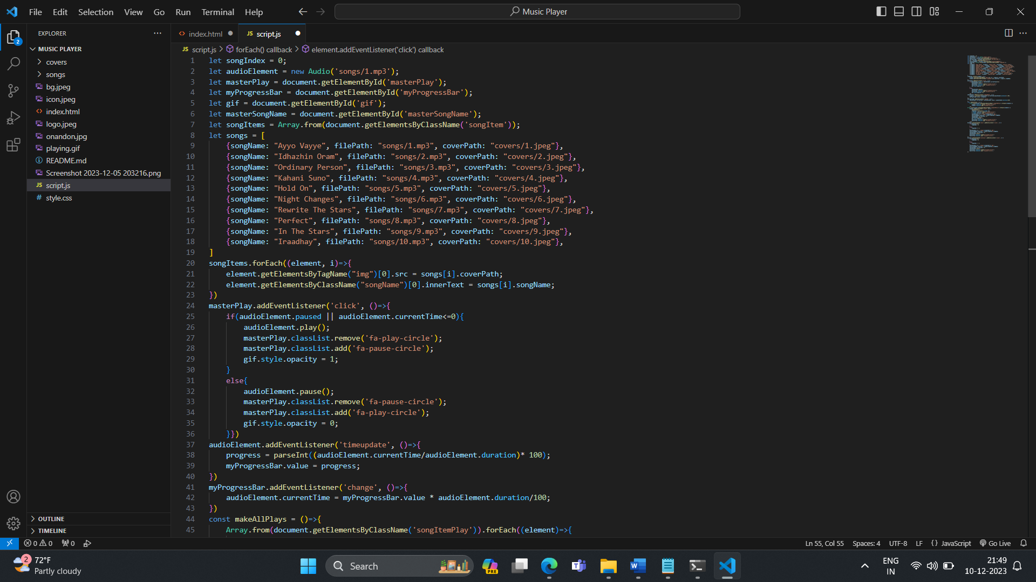
JAVASCRIPT CODE:

Slide 17
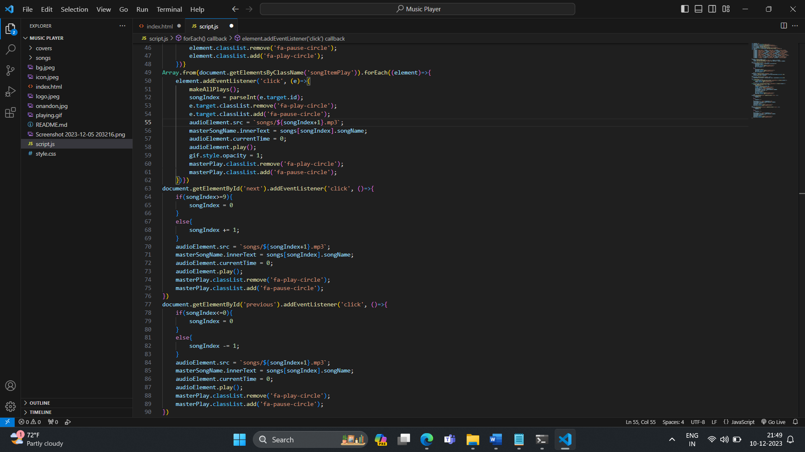

Slide 18
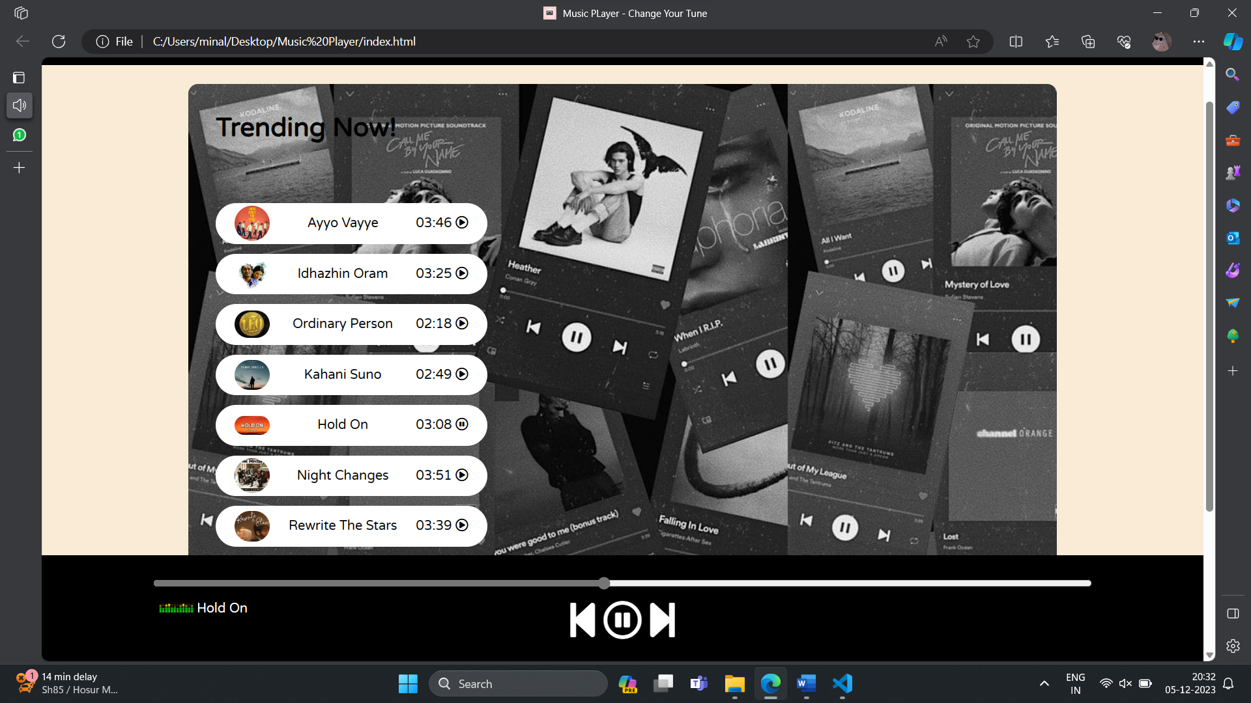
SNAPSHOT

Slide 19
REFLECTION/LEARNINGS
Configuring Visual Studio Code
HTML Basics
Frontend Exploration with React
Understanding React Components
Introduction to Node.js
Login/sign up page development
Firebase Integration
Setting up firebase
Connecting Firebase to project
:

Slide 20
CONCLUSION
The music player website aims to provide a seamless and enjoyable music listening experience.
Additionally, features like personalized recommendations and offline listening enhance user satisfaction, making it a comprehensive platform for music enthusiasts.
In conclusion, embracing full-stack web development empowers professionals to build end-to-end solutions, stay adaptable in a dynamic tech landscape, and play pivotal roles in shaping the digital experiences of tomorrow.

Slide 21
REFERENCES
Wikipedia
Geeksforgeeks
Youtube

Slide 22
THANK YOU

Slide 23
ANY QUERIES?

